Slide 1
YELP DATA ANALYSIS
Sentiment Analysis of Reviews
Notes:
Good afternoon,

Slide 2
01
02
03
04
Does Yelp need a makeover?
Data Wrangling
Topic Modelling
What’s next?

Slide 3

Does Yelp need a makeover?
01
Data collected about businesses, user generated content for reviews along with user attributes & activity monitoring.
Yelp is a platform for businesses to receive feedback from consumers in the form of text reviews and star ratings.

Slide 4
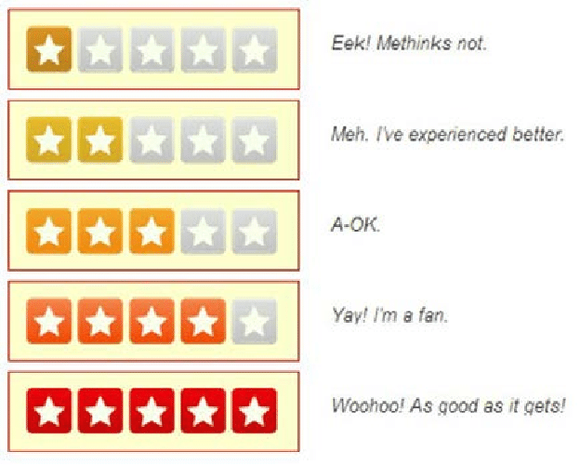
“What can we do better?”
“This is the worst beyond meat burger in Toronto”
“Lactose-free strawberry gelato? Count me in!”
Users can post reviews & ratings on a scale of 1 to 5. .
Users can also have “friends”,
“fans” and even react to other reviews.
Using text analytics to analyse
reviews, we can understand what users are most appreciative of.
Further, we can predict important features to a specific cluster of users, which can be found by analysing user features & social networks.
To incentivize users to post reviews & drive engagement to generate more insights, Yelp should focus on consumer metrics. Revenue can be multiplied with social features that enable e-wom marketing.
Notes:
Yelp measures consumer engagement with online reviews on its platform in the form of "votes" that are generated by users. A consumer centric approach focuses on improving user activity in terms of user review count, "tips" for the restaurant, time spent on the platform, and social interaction such as voting on reviews, finding friends and following top Yelper's, among searching for new restaurants & checking into restaurants when they dine there.
However, upon exploration most of these fields are found to be nulls or unevenly distributed across our dataset. This suggests that Yelp should reconsider it's interface design & metrics for both users and businesses. Online platforms such as Yelp rely heavily on their users to generate content & provide data for insights for the businesses & popularity of their platform. In this context, it is crucial to filter content that is considered "high quality" from both a business & consumer standpoint. Apart from fake & real review detection, understanding the social feedback mechanism of peer evaluation in Yelp's online community is important to drive up the profit reaped by users, businesses as well as Yelp.

Slide 5

Understanding Online Reviews: Funny, Cool or Useful?
Yahoo Labs research into member interaction on online review platforms, using the Yelp dataset to understand the distribution of “votes” as an indicator of social perception.
Notes:
a deeper understanding of the social perception of these "votes" as user feedback can help design better recommendation and social networks. They found that active and older members tend to engage more on the platform, by writing more reviews and reacting to other reviews. Reviews with a higher word count are perceived as more "useful" overall by the community, while those who give higher ratings are perceived as "cool" and review with a negative tone are more likely to be voted "funny" by other users. Additionally, they found that new businesses can generate a "review momentum" by receiving more "useful" votes on initial reviews by users, which helps establish the business.

Slide 6
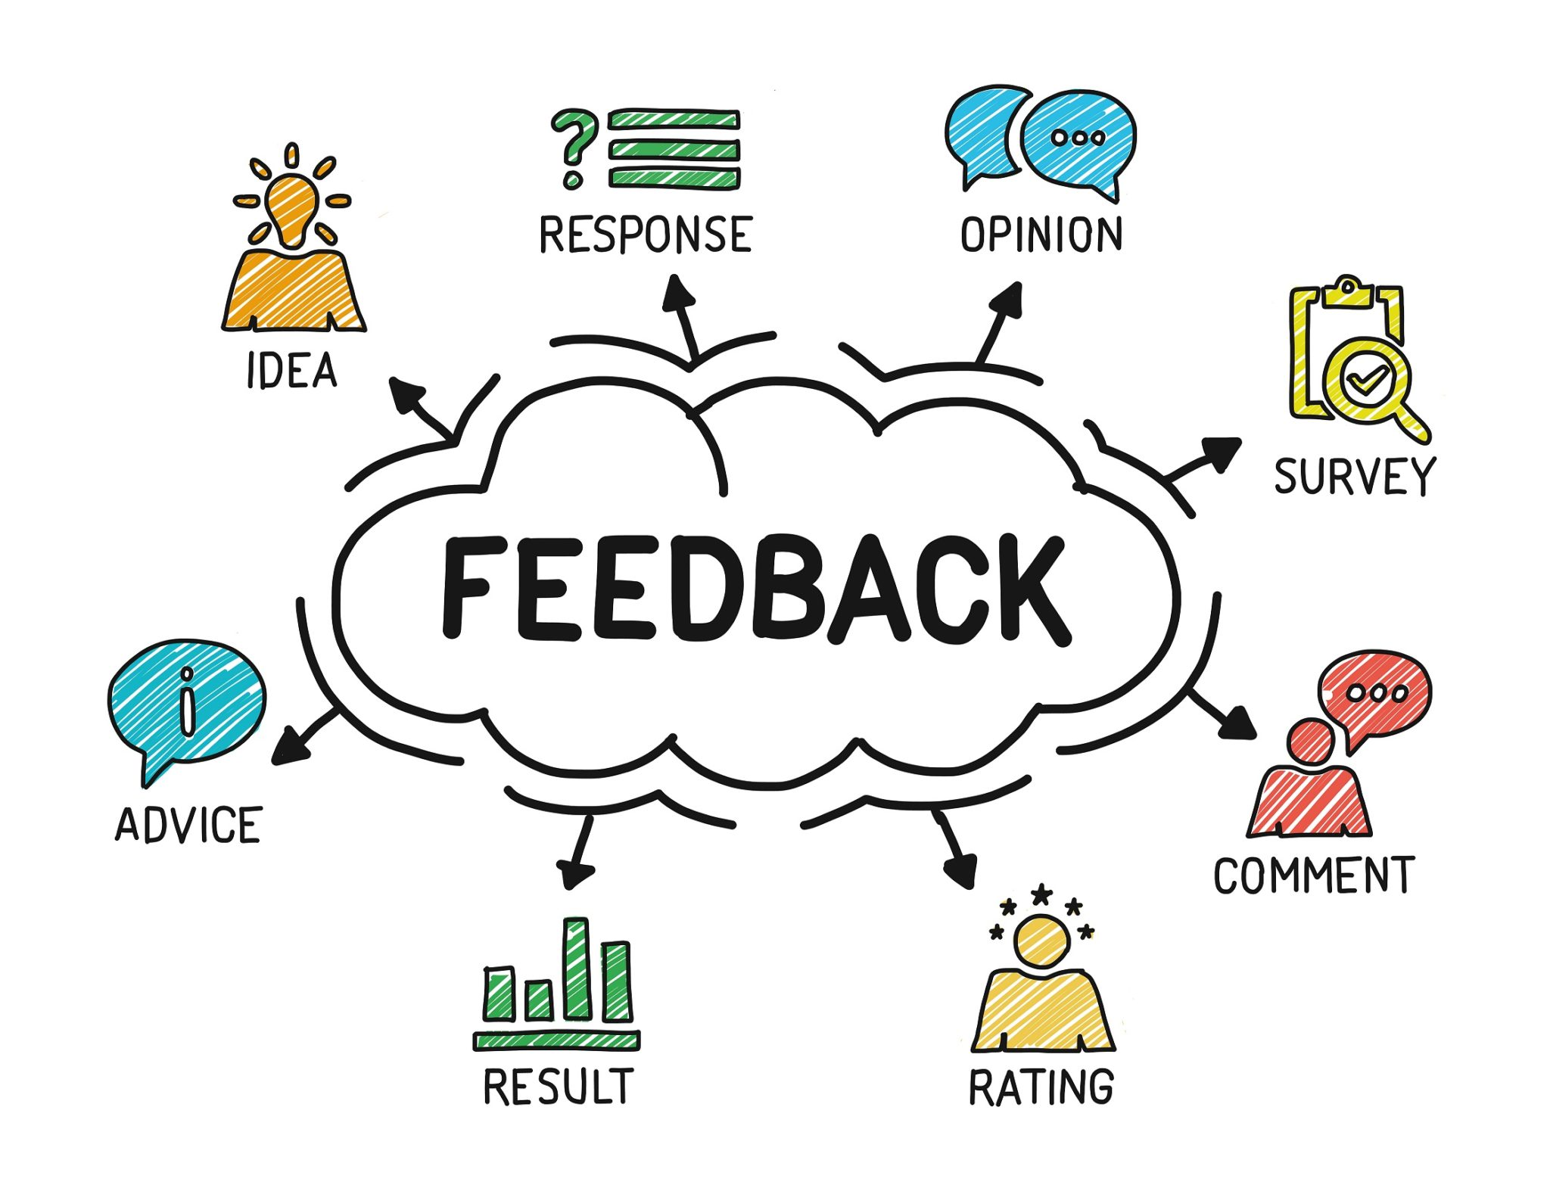
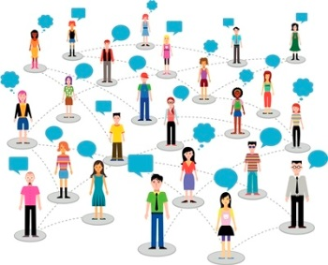
1. Business Insights from Text Analysis & Sentiment Prediction of Reviews
2. User Clustering & Social Network Analysis to incentivize writing more reviews.
Notes:
This suggests that Yelp can use the user generated review text and corresponding member reactions as inputs to generate better recommendations. Further, Yelp can "start a new conversation between the voter and the reviewer" around a particular topic & thereby, create a meaningful social network. This ties into the E-WOM (electronic-word-of-mouth) marketing concept by using "influence" from top active & older members to set a trend in the community regarding the social perception of the business.
Using a sentiment analysis model to understand the user's opinion of the business from review text & the corresponding rating can be used for topic modelling & identifying key business attributes predicting these ratings. User generated content can be improved by incentivizing reviews written by old and experienced users. This not only provides other users with a sense of confidence in the recommendation, but also paves way for a social aspect to member interaction. This can be achieved by using member levels, as seen in several e-commerce channels, to segregate active & experienced Yelper's from new Yelper's.
Yelp has redesigned it's platform for businesses by segregating categories, including popular trends seen in the market as insights and providing a platform for blogs. With respect to the user community, there is an opportunity in improving the recommendation system & data generated by the users. Yelp could model their interface to be better positioned towards users, such as the browsing feed to be curated with pictures from user's social media platforms, as a promotional blog. This will improve their photo & check-in database along with generate content for Yelp in a collaborative manner. Using graphic call-to-action "vote" reactions to reviews could help increase user interactivity.

Slide 7
“How can we do better?”
Classification & Transfer Learning for Sentiment Analysis
Exploratory Data Analysis
Preprocessing & Sampling
Increase Customer Satisfaction & Revenue
Notes:
This requires us to conduct EDA & preprocessing to calculate the public perception of the restaurant on Yelp, then model a Logistic Regression model to accurately classify the review based on sentiment analysis using NLP.
We can further apply this model to a single restaurant and identify the key aspects of that restaurant that drive overall customer perception

Slide 8
02
Data Wrangling
Open Source available on Yelp API
Big Data Processing (AWS)
Selection of Data
Data Cleaning & EDA
Feature Engineering
Preprocessing
Visualizations (Tableau)
Vectorization (TFIDF)

Slide 9
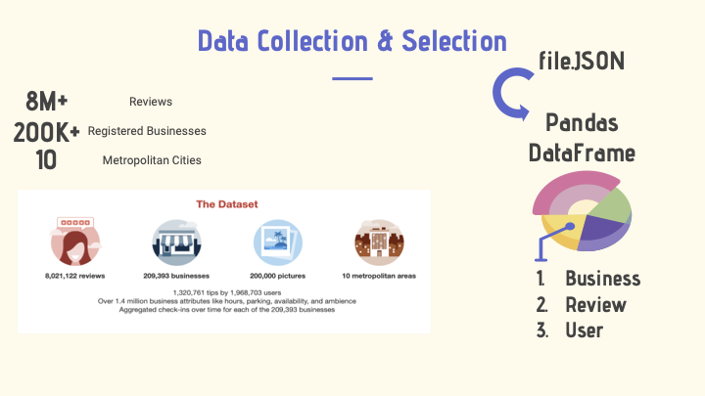

Slide 10
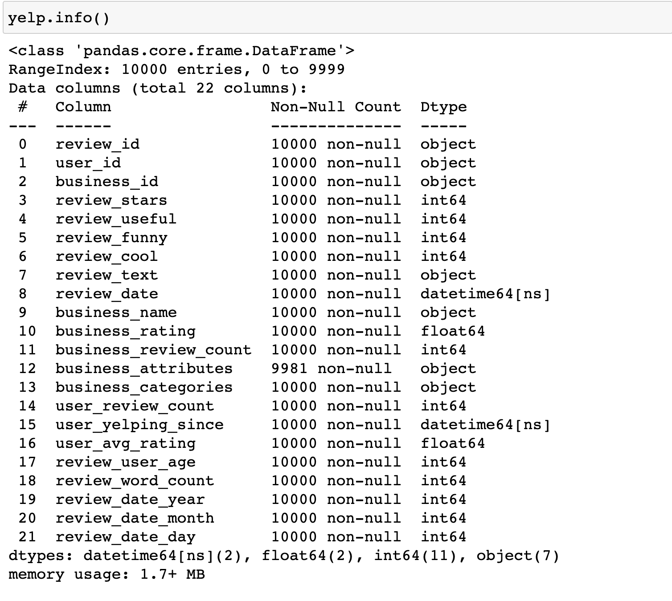
Sample of 10,000 reviews from Yelp with corresponding business & user data points

Slide 11
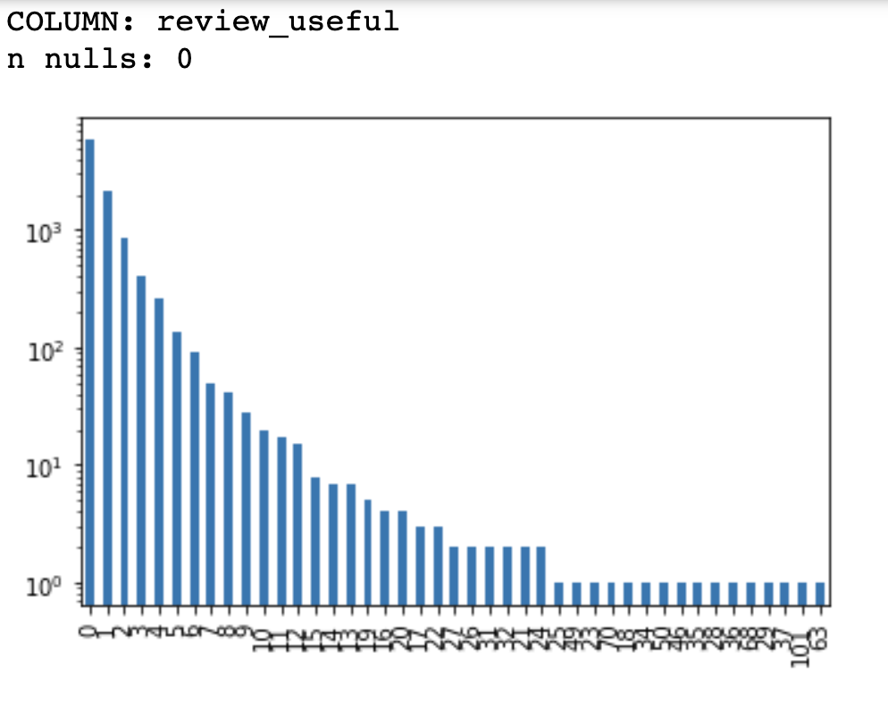
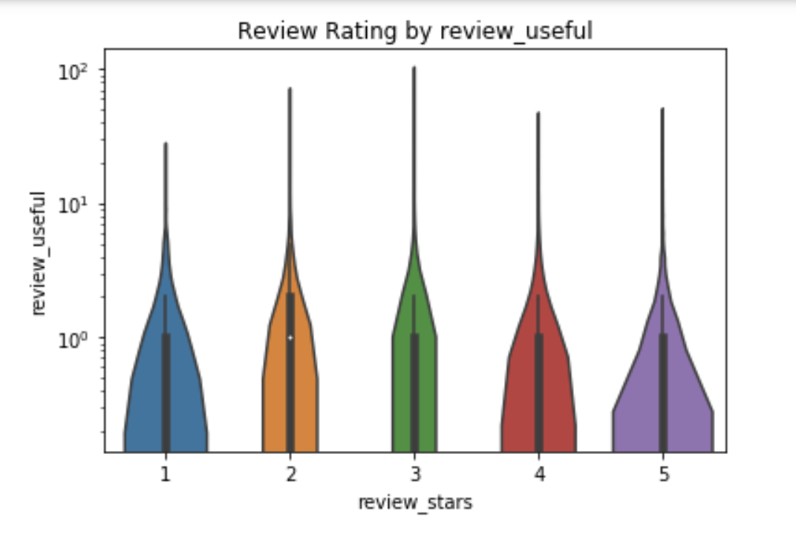
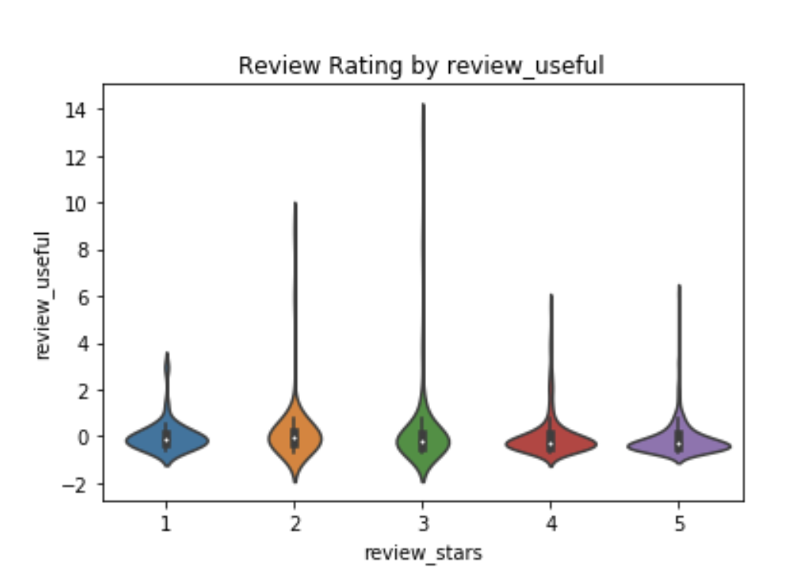
EDA: review_useful votes w.r.t. review_stars on reviews for restaurants.
Without Scaling:
Upon using Standard Scaler:

Slide 12
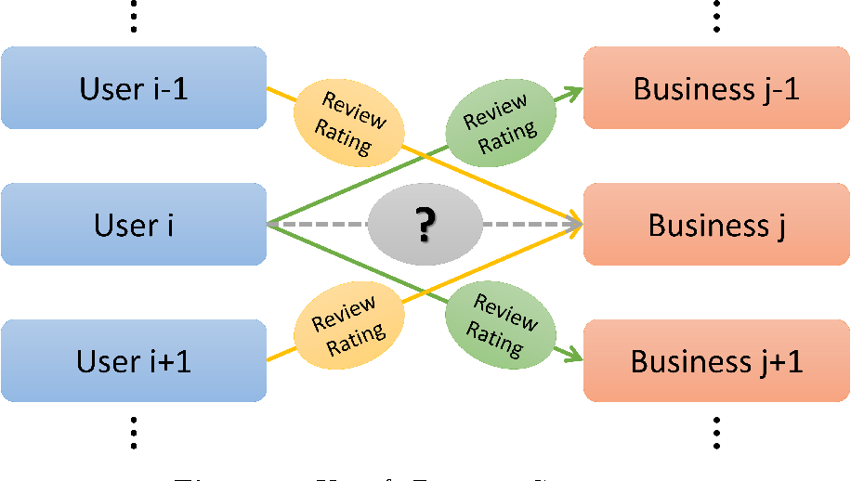
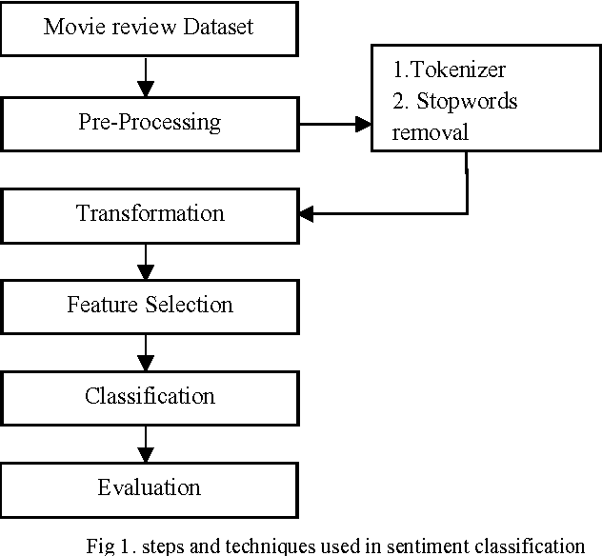
Post EDA:
Yelp Review Dataset

Slide 13
Topic Modelling
03
Supervised Learning Models for Classification:
Logistic Regression
K-Nearest Neighbours
Decision Trees & Random Forest
Support Vector Machines
Transfer Learning Alternative - FastAI model

Slide 14
What’s Next?
04
Clustering of users based on user attributes & topic modelling from review text.
Focusing on CPI instead of KPI to drive platform engagement & business revenue
Successful analysis of customer sentiments to improve review engagement, predict score distribution & allowing Yelp to maximize their Customer Lifetime Value.

Slide 15
Thank You
Questions & Comments?
lavanya.kwatral@gmail.com
https://www.linkedin.com/in/lavanyakwatra/

